Slide 1
Chapter 27 to 29
Electro-Magnetic Induction and Field
The Law of Electro-Magnetic Induction
Motional & Induced EMF
Self and Mutual Induction
Energy Stored in a Magnetic Field
Displacement Current & Ampere-Max’ Law
Maxwell’s Equation

Slide 2
27-1. Electro-Magnetic Induction’Law
After Oersted’s discovery in 1820: a steady current produced a steady magnetic field. Experimentalists eagerly sought to demonstrate the reverse: a steady magnetic field could create a steady electric current.
Michael Faraday (1791-1867), English physicist and chemist, whose experiments covered a wide range of electrical, magnetic, optical and chemical phenomena. He is best known for his discovery of electro-magnetic induction.

Slide 3
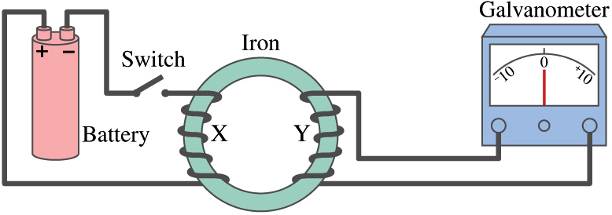
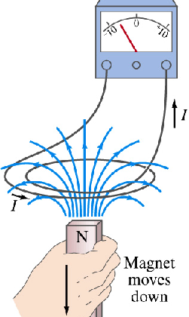
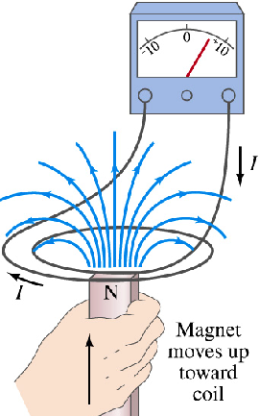
1. Faraday’s law of induction (P630)
Common points:
Flux of changes and electromotive force (EMF) (电动势)occurs.

Slide 4
The magnitude of the EMF induced (感应电动势)in a conducting loop is equal to the rate at which the through that loop changes with time.
(Faraday’s law)
where is magnetic flux through area A.
SI unit:
1 weber = 1Wb = 1T · m²
volt (V).
For a coil of N turns (the coil is closely packed, the same magnetic flux passes through all the turns, the total EMF induced in the coil is:
(coil of N turns)

Slide 5
The steps to determine the direction of i by Faraday’s law:
(1) Freely set a positive normal direction of a loop ;
(2) If
(3) If
L
L

Slide 6
Explanations:
(1) If the loop’s resistance is R, then induced current in the loop is:
(2) The charges in the loop (通过回路的电量)is:
The charges q is directly proportional to ΔΦ and independent on dΦ /dt .

Slide 7
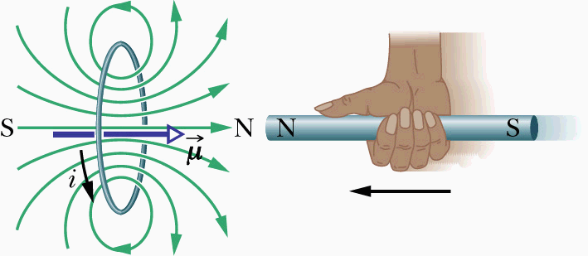
2. Lenz’s law
⎯⎯ determining direction
(Heinrich Friedrich Emil Lenz, a German physicist, in 1834 he proposed this law.)
An induced current has a direction such that the magnetic field due to the current opposes the change in the magnetic flux that induces the current (感应电流的方向总是使它产生的磁场去阻碍引起感应电流的磁通量的变化).
Self-loop’ magnetic flux
original
opposing
Look at P631, please!

Slide 8
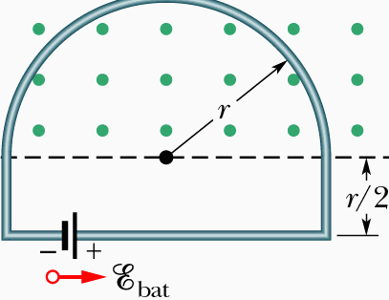
Example:
As Fig. a conducting loop, r =0.2m
Question:
(a) The magnitude & direction of ?
(b) The current in the loop at t = 10s?
Solution:
(a)
(clockwise)
(b)

Slide 9
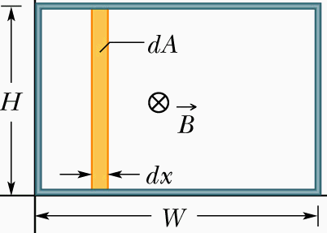
Example:
y
Given:
Question:
x
The magnitude & direction of ?
Solution:
Direction: with time, induced emf is counterclockwise.

Slide 10
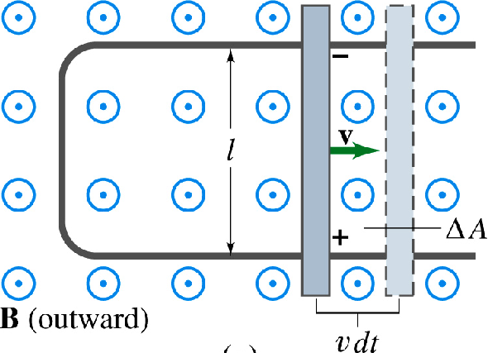
27-2. Motional & Induced EMF
1. Motional electromotive force (P634)
The conducting rod ab is sliding along the metal rails and across
d
a
a'
I
I
b
x
c
b'
Direction: from a to b.
Microscopic view, EMF is induced by Lorrentz’ force,

Slide 11
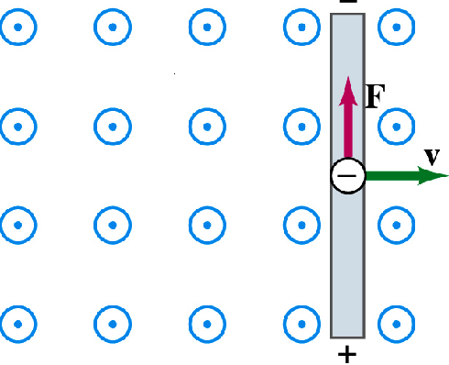
Explanations:
uniform
(1) Motional EMF is, in nature, the work done by Lorentz’s force to transfer a per unit positive charge from point a to b.
(2) This motional EMF is not present in a static system. The moving part is analogous to a chemical device for generating electric current. ( from low electric potential to high).
b
(3) coincides with Faraday’s law.
a

Slide 12
(4) The condition creating motional EMF: moving conductor must cut the magnetic field lines. So, we can picture the motional EMF as the time rate of cutting the magnetic field lines.
(5) Relationship of work-energy: to maintain motion of conductor,requiring applied force to do positive work. The energy transfered to the closed loop + magnet system via the force ends up in thermal energy外力克服安培力作功，转化为电能.
Look at and work out examples 27-3 and 27-4 by yourself after class!

Slide 13
Example:
A conducting wire of length L rotates about O with ω in uniform magnetic field which is perpendicular to rotating plane. Find (a) ε = ? (b) Which point has higher EMF?
Solution:
Way I:
×
×
×
×
×
×
×
v
A
×
×
×
×
×
×
×
×
×
×
×
×
×
θ
O
dl
×
l
x
×
×
×
L
×
×
×
×
Point O has a higher EMF.
×
×
×
×
×
×
×
×
×
×
×
×
Way II:
Making up a closed loop and using Faraday’s law.

Slide 14
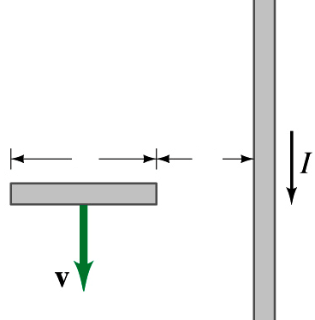
Example:
As the figure, a straight wire of length l (MN) is put horizontally and free-fall. What is the potential difference of two side the wire at time t (经时间t 导线两端电位差).
Solution:
Setting x axis as the figure,
N
M
l
a
x
dx
x
O
Point M has a higher EMF.
Work out Problem 27 of P641 after class.

Slide 15
2. Induced electric fields and EMF (P635)
Induced electric field arising from the changing of magnetic field with the time.
From the definition of EMF (电源的电动势):
(in P566)
Induced EMF equals to the circulation of induced electric field (感生电动势等于感生电场场强的环流).
Connect with the law of Faraday,
Take notes!

Slide 16

Notes！
A changing magnetic field produces an electric field even if there is no conducting loop.
The features of induced electric field:
(1) It also has acting force on charged particle as static electric field does (感生电场对电荷有作用力).
(2) It is origin from varying magnetic field.

Slide 17
(3) Comparing with the loop law of electrostatic field, we may find that induced field is another kind of electric field.
The source of are charges and changing , respectively. is a curl electric field (有旋电场), its lines are closed (no head and no tail) — nonconservative field, and no potential.

Slide 18
The calculation of induced electric field:
It can be calculated when has some symmetry by using equation:
Example 27-5:
A long solenoid of radius R, find the distribution of when the magnetic field inside of it varies with time (dB/dt=C).
×
×
×
Solution:
R
×
×
×
×
×
From symmetry, is tangential direction, freely assume positive direction of and L as the figure:
r
×
×
×
×
×
L
×
×
×
×
×
×
×
×

Slide 19
×
×
×
R
×
×
×
×
×
r
×
×
×
×
×
L
Note the sign!
×
×
×
×
×
(1) If r < R (inside),
E_{i}
×
×
×
(2) If r > R (outside),
R
r
O
E-r curve
If dB/dt >0, direction of is the same as assumed (counterclockwise); otherwise, opposite.

Slide 20
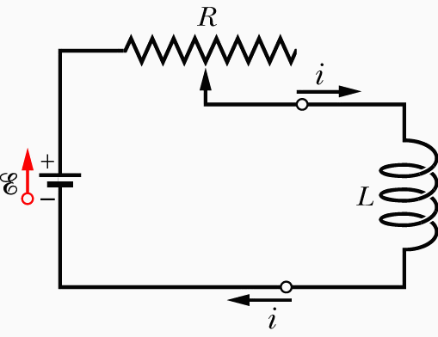
27-3. Self-Induction & Mutual Induction
1. Self-Induction (自感应)(P645)
The process that an induced EMF appear in any coil in which the current is changing is called self-induction (由于自己线路中的电流的变化而在自己的线路中产生感应电流的现象－－自感现象).
If we establish a current I in the windings, the magnetic flux linkage NΦ is proportional to I,

Slide 21
Then the coefficient L is defined as the inductance of the inductor:
(Inductance defined)
The inductance L is a measure of magnetic flux linkage produced by the inductor per unit of current.
It related to the geometry of the windings and magnetic medium. Its SI unit:
1 henry (亨利) = 1 H = 1T·m²/A

Slide 22
The EMF appears in self-induction is called self-induced EMF. It obeys Faraday’s law of induction.
(self-induced EMF)
The minus sign indicates that the self-induced EMF has the orientation such that it opposes the change in I.

Slide 23
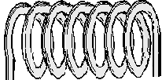
Inductance of a solenoid:
Considering the case as figure (N, l)
Magnetic field inside the solenoid of length l is:
I
Magnetic flux linkage:

Slide 24
The inductance per unit length for a long solenoid near its center,
Hey!
Inductance L —— like capacitance ——depends only on the geometry of the device.

Slide 25
Example:
Calculating self-inductance of co-axis wire in unit length (同轴电缆单位长度的自感).
R₂
I
Solution:
R₁
I
r
l
r
dr
l

Slide 26
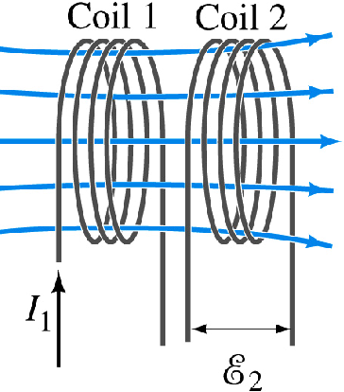
2. Mutual-induction (互感应)(P643)
A steady current in one coil will set up a magnetic flux linking the other coil. If current changes with time, an EMF appears in the second coil. The process is called mutual induction.
Define the mutual inductance M₂₁ of coil 2 with respect to coil 1 as （线圈1对2的互感系数）：

Slide 27
If, by external means, we cause I₁ to vary with time, then
According to Faraday’s law (with a minus sign to indicate direction):
(compare to )
By similar way (interchanging the roles of coils 1 and 2) ,

Slide 28
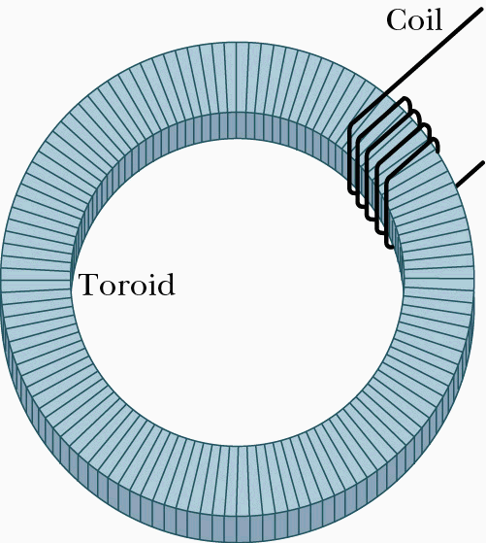
The EMF induced in either coil is proportional to the rate of change of current in the other coil.
It can be proved:
The SI unit for M (as for L ) is also the Henry.
In general, M should be measured in experiments.
Example:
A coil of N₂ turns wound as shown around part of a toroid of N₁ turns. The toroid’s inner, outer radius are a and b, its height is h. Show M for the toroid-coil combination.

Slide 29
Solution:
Look at example 28-1 of P644 after class!

Slide 30
27-4. Energy Stored in a Magnetic Field (P647)
Recall the energy stored in electric field:
Energy of capacitor:
Density of energy:
To get magnetic energy, consider such a RL circuit:
R
L
ε
Using Ohm’s on it:
K₁

Slide 31
Multiply each term by Idt and integrate, we have
Energy stored by an inductor:
R
L
On the other hand, if U_{B} is known, L can be gotten from this equation.
ε
K₁

Slide 32
Take long solenoid as an example,
The energy stored per unit volume of the field, density of energy (能量密度), is:
(magnetic energy density)
In general, one can use:
Discuss example 28-5 in P648 as follows.

Slide 33
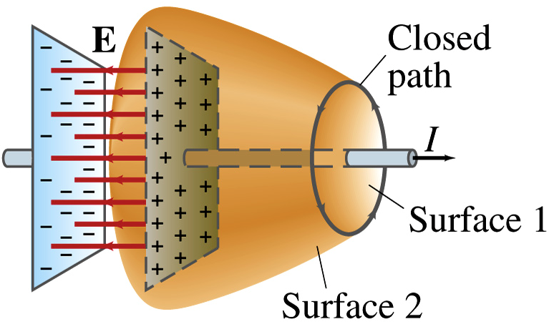
27-5. Displacement Current & Maxwell Equations
1. Displacement current (位移电流)(P661)
The introduction of displacement current is the basis on which Maxwell (English physicist James Clerk Maxwell) equations are set up.
Using Ampere-loop law to S₁, and S₂,
one get:
L
and
S₁
S₂
They are contradict. To make them coordinate, we need to consider the continuity of current.

Slide 34
Using Gauss’ law to the closed surface made of S₁ & S₂:
when S₁ far from plates
From:
Real current in conducting wire = changing rate of electric displacement flux to time through surface S₂.

Slide 35
So, at non-steady current, Ampere law can be rewritten as:
(Ampere-Maxwell law)
Explanations:
(1) Fictitious (假想的)displacement current between the plates is associated with that changing E-field. (通过某个面积的位移电流为通过该面积的电位移通量对时间的变化率).

Slide 36
(2) The displacement current given by Maxwell is, in nature, that a changing electric flux will always induce a magnetic field whenever it occurs.
(3) Although I and I_{d} are equivalent at producing magnetic field, they are different in that displacement current is varying electric field 位移电流是变化的电场,可以存在于一切物质或真空中而传导电流是导体中电荷的定向运动.
Look at Example 29-1, please !

Slide 37
2. Maxwell’s equations (P667)
Maxwell’s Equations written on the assumption that no dielectric or magnetic materials are present:
or
Take notes!

Slide 38
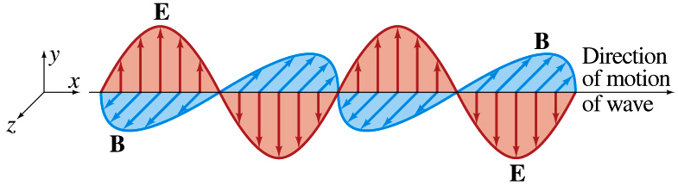
The assumption of displacement current and induced magnetic field result that Maxwell proposed expectation (预言) of electromagnetic wave. 20 years later, Hertz verified it by experiments.
c
All electromagnetic waves, including visible light, have the same speed c in vacuum (电磁场在真空中的传播速度就是光速c ) and light is the electromagnetic wave.

Slide 39
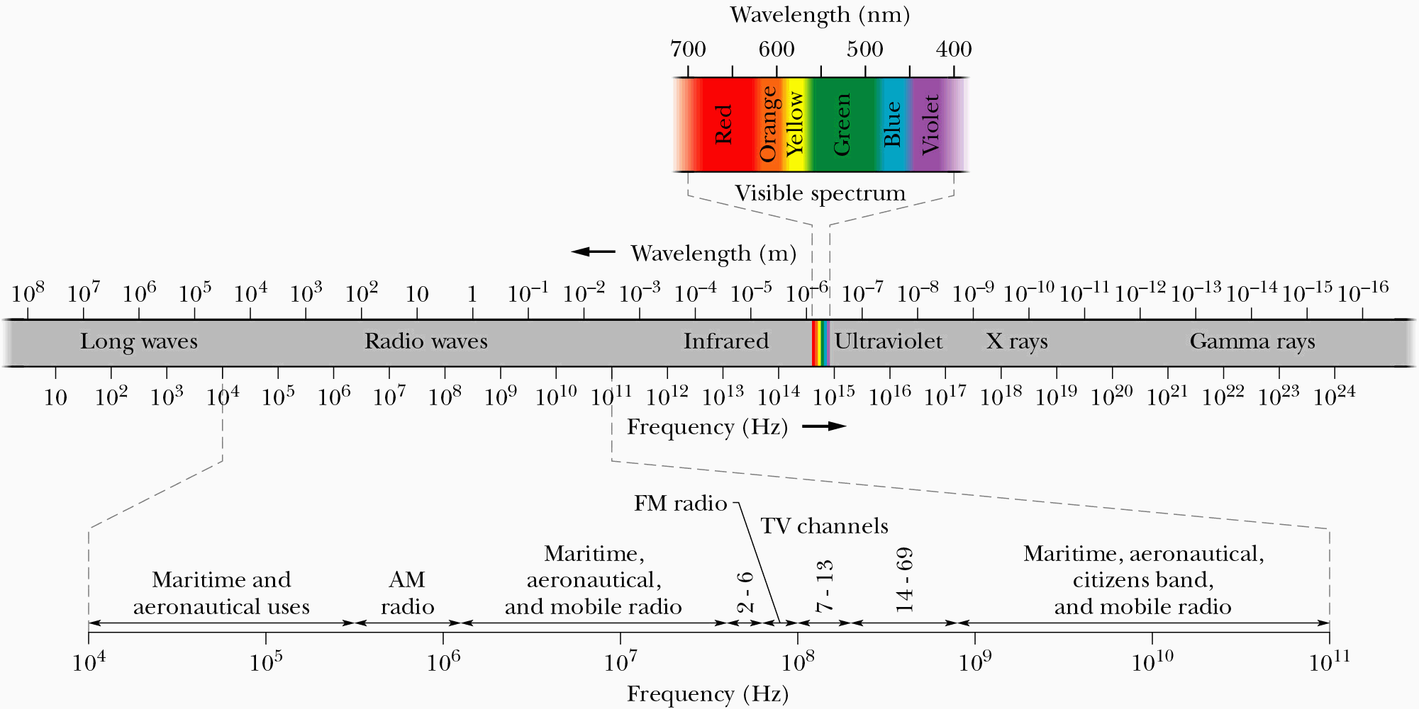
This figure shows, we now know a wide spectrum of electromagnetic waves, referred to by one imaginative writer as “Maxwell’s rainbow”.
P671

Slide 40
Example:
In the region of radius R, a conductor wire ab is put in uniform . Find its EMF if is constant.
Solution:
In the radial direction,
So we may make a closed loop obao by adding oa and ob.
R
O
a
b
l

Slide 41
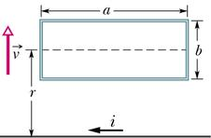
Example:
A rectangular loop of wire with length a, width b, and resistance R is placed near an infinitely long wire ( i ). The distance between their center is r. Find (a) the magnitude of the magnetic flux through the loop and (b) the current in the loop as it moves away from the long wire with speed v.
Solution:
(a)

Slide 42
(b)
When the loop moves far away, the direction of current in it will be clockwise.

Slide 43
The problems of chapter 27:
7, 11, 14, 16, 19, 21, 23, 27, 40, 41, 42, 43
The problems of chapter 28:
30, 35, 37, 38, 39

